Slide 1
UE21CS320A– Project Phase – 1
End Semester Assessment
Project Title :Indexing and Summarization of Sports
Videos using Multi-Modal Approach
Project ID :61
Project Guide :Dr. Sandesh B J
Project Team :PES2UG21CS242 (Krupashree M V)
PES2UG21CS289 (Meenal Bagare)
PES2UG21CS294 (Melvin Jojee Joseph)
PES2UG21CS324 (Naveen Kumar Reddy G)

Slide 2
Agenda
Introduction and Motivation
Problem Statement
Abstract and Scope
Literature Survey / Existing System
Suggestions from Review – 3
Requirements Specification
Design Approach
Design Constraints, Assumptions & Dependencies
Proposed System / Approach
Architecture
Design Description
Project Report and Progress
References

Slide 3
Introduction and Motivation
In today's fast-paced world, sports enthusiasts lack time for full-length game viewing.
The process of creating sports summarization involves a manual, time-consuming process.
Large editing teams review entire game footage, select key moments, and compile highlights.
This manual approach is resource-intensive and may lead to uneven coverage of events.

Slide 4
Problem Statement
Revolutionizing sports video summarization through multi-modal approach.
Leveraging the power of Twitter data, audio features, and video content to automate and enhance the summarization process.
We aim to integrate the audience reactions from Twitter, analyze audio cues for significant moments, and process video footage for visual highlights.

Slide 5
Abstract and Scope
Streamlined Summarization: The integration of multiple data sources streamlines the summarization process, making it more efficient and effective.
Engaging Highlights: Through our approach, we aim to deliver engaging highlights to sports enthusiasts worldwide, enriching their viewing experience.
Transformational Potential: This innovative approach has the potential to transform sports summarization into a scalable and efficient solution, benefiting both content creators and viewers.

Slide 6
Abstract and Scope
Integration of Multiple Data Sources: Our sports summarization approach combines Twitter data, audio features, and video content to enhance the summarization process.
Efficiency Over Manual Editing: Unlike traditional manual editing methods, our approach offers efficiency by automating the summarization process.
Broader Coverage: By leveraging diverse sources of information, our method provides broader coverage of sports events compared to manual editing, which can be limited by time and resources.

Slide 7
Suggestions from Review - 3
It was suggested that we look into enhancing of Time Lag Model implementation.
Research on leveraging of pre-trained models.
It was suggested to look into how we would handle significant events that vary by just a few seconds.
Investigate the current implementation of match replay action, enhancing it and using it as our model for validation.

Slide 8
Summary of Literature Survey in Review 3
Research paper encompasses various approaches to video summarization and event detection across different sports, including baseball, soccer, cricket, and others.
Innovation techniques such as Multimodal Variational Autoencoder(Tl-MVAE), machine learning (YOLO v3 and OpenPose), LSTM with attention mechanism show promising result in accurately summarizing key event in sports video.
Challenges addressed include time-lags between events and tweets,enhance accuracy of action recognition and event detection in various sporting event.
Challenges in video summarization include data dependency, potential error in event detection,depend on data quality, and dependency on keyword frequency in text stream analysis.
These research papers collectively offer valuable insights into enhancing summarization accuracy, efficiency, and scalability in sports video analysis,highlighting areas for further exploration and improvement.

Slide 9
Summary of Literature Survey in Review 3
Citation: Hirasawa K, Maeda K, Ogawa T, Haseyama M. Detection of Important Scenes in Baseball Videos via a Time-Lag-Aware Multimodal Variational Autoencoder. Sensors (Basel). 2021 Mar 14;21(6):2045. doi: 10.3390/s21062045. PMID: 33799412; PMCID: PMC7999231.
Objective: The objective of the paper is to propose a method for the detection of important scenes in baseball videos via the MVAE considering time-lags between tweets and corresponding multiple previous events.The Tl-MVAE consists of an encoder, decoder and an important scene detector. The paper uses Poisson distribution to account for time-lags.
Advantages: Tl-MVAE can correctly consider the relationships between tweets and videos.Experimental results confirmed that the Tl-MVAE realizes the accurate detection of important scenes of baseball videos. Since the immediately previous event strongly influences the tweet and the influence of past events tends to be gradually weakened, the paper adopts Poisson distribution for the consideration of time-lags.
Limitations: The performance of the proposed method could be sensitive to the choice of Poisson distribution parameters. Finding the optimal values for these parameters might be challenging. Also, the proposed model involves complex mathematical models and neural networks which might require significant computational resources for training.

Slide 10
Summary of Literature Survey in Review 3
Citation:Raj, R., Bhatnagar, V., Singh, A. K., Mane, S., & Walde, N. (2021, January 21). Video Summarization: Study of various techniques. arXiv.org. https://arxiv.org/abs/2101.08434
Objective: The objective of the paper is to develop an innovative approach for summarizing football match videos using advanced technologies, with the ultimate goal of improving user accessibility and experience in consuming video content.
Advantages:The paper introduces a novel approach to video summarization, leveraging deep neural networks and semantic mapping techniques. This innovative method offers a fresh perspective on how to efficiently summarize videos.
Limitations:Data Dependency: The effectiveness of the approach may heavily depend on the availability and quality of training data. If the training dataset is limited or biased, it could result in suboptimal performance or biased summarizations

Slide 11
Summary of Literature Survey in Review 3
Citation: H. Sattar, M. S. Umar, E. Ijaz and M. U. Arshad, "Multi-Modal Architecture for Cricket Highlights Generation: Using Computer Vision and Large Language Model," 2023 17th International Conference on Open Source Systems and Technologies (ICOSST), 2023, pp. 1-6, doi: 10.1109/ICOSST60641.2023.10414235
Objective: The objective of this paper is to leverage large language models to aid in the generation of sports summaries. The approach mentioned in this paper used the YOLO model in order to split the video into 20 second segments based on the bowler’s position and later feeds the commentary data into a large model that is trained to identify events based on words used for each event.
Advantages: The approach used in this paper has an accuracy of roughly 97% which has been achieved due to large corpus of words that has been identified for each type of event. The use of a BERT that has been fine tuned for English commentary data has also aided in achieving such high level of accuracy.
Limitations: Misclassifications occur when the commentators describe the game’s bigger picture, separate from the actual ball action, such as boundaries and wickets. There are also times when ball actions come to an abrupt end, which causes a discrepancy between the extracted comments and the real event sequence. The commentary’s temporal misalignment separates the model’s narrative depiction from the real event.

Slide 12
Summary of Literature Survey in Review 3
Citation: Z. Saeed, R. Ayaz Abbasi, M. I. Razzak and G. Xu, "Event Detection in Twitter Stream Using Weighted Dynamic Heartbeat Graph Approach [Application Notes]," in IEEE Computational Intelligence Magazine, vol. 14, no. 3, pp. 29-38, Aug. 2019, doi: 10.1109/MCI.2019.2919395
Objective: Weighted dynamic heartbeat graph for detecting event in a dynamic text stream like social media data like twitter, Weighted Dynamic Heartbeat Graphs (WDHG) capture evolving word usage over time. Key features, Growth Factor (GF) and Aggregated Centrality (AC), enabling the detection of significant events by classifying and ranking strong snapshots.
Advantages: WDHG efficiently detects and highlights emerging topics in dynamic text streams.
suitable for processing large volumes of Twitter data in real-time event detection scenarios.
Limitations:Dependency on Keyword Frequency: The method heavily relies on keyword frequency, which may lead to biased results, especially in noisy or diverse text streams. The approach may face challenges in handling bursty events where topics rapidly gain popularity and decline.

Slide 13
Functional Requirements
Automated Data Analysis: The system automatically identifies significant event in sports data by event extraction during high twitter activity and it cross verifying with commentator excitement,audiences cheers and incorporates real time scoreboard data.
Efficient Data Processing: Efficiently processes large volumes of data in real-time,dynamically adjusting capabilities to handle increased twitter data during high activity.
Noise Handling: Effectively deals with filtering out noise and maintains accuracy in identifying key moments.
Highlight Generation: Automatically selects and compile the most important or exciting moment from the game into a highlight reel.

Slide 14
Functional Requirements
Accuracy In Key Moment Detection: The System Should Strive For High Accuracy In Identifying Key Moments Within The Game Footage
Faster Processing Speed Than Manual Methods: The System Should Generate Summaries Significantly Faster Than Manual Editing, Ideally Near Real-Time For Live Games.

Slide 15
Non - Functional Requirements
Performance Requirements :
Efficiency: The system should efficiently process large volumes of audio, video, and Twitter data in real-time.
Response Time: The system should process sports videos and
generate highlights in very less time.
Scalability: The system should be scalable to accommodate an
increasing number of users and diverse sports events without
compromising performance.

Slide 16
Non - Functional Requirements
4. Reliability: The system should reliably detect and highlight significant events in sports videos.
5. Robustness: The system should gracefully handle variations in video quality, noise, and unexpected data patterns.

Slide 17
Non - Functional Requirements
Safety Requirements :
Data Integrity: Ensuring the integrity of the data is crucial to providing accurate and reliable sports highlights.
User Safety: Measures to protect user privacy by anonymizing and securing any personal information collected during the extraction of tweets corresponding to significant events.
Backup and Recovery: Implementing robust backup and recovery mechanisms to prevent data loss and ensure system stability.

Slide 18
Non - Functional Requirements
Security Requirements :
Data Privacy: Ensure the privacy of user data, especially comments, tweets, and any personally identifiable information.
Access Control: Implement to ensure that only authorized users can perform certain actions, such as accessing sensitive data.
Secure Communication: Integration with Twitter, ensure the security of communication and data exchange.

Slide 19



Technologies Used
OpenCV: Used for video processing tasks such as extracting frames, detecting scoreboard, and analyzing visual content.
Python: The primary programming language for implementing the project. Python has a wide range of support for various machine learning and computer vision libraries.
TensorFlow: Deep learning frameworks for implementing advanced models such as neural networks for audio and visual analysis, as well as integrating pre-trained models like OpenAI's whisper model for audio transcription.

Slide 20
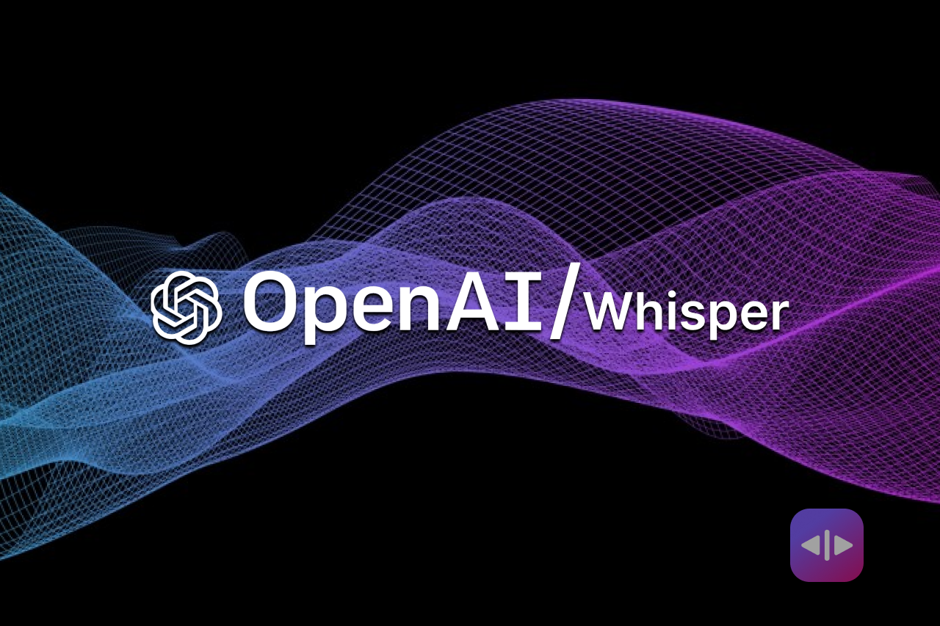

Technologies Used
OpenAI’s Whisper model employs speech recognition algorithms to transcribe commentator speech or audio commentary from the sports event into text.
Google Bert, an open source large language model that will identify events by going through the commentary data of the sports video.

Slide 21
Design Approach
Multi-Modal Approach:
Integrates data from multiple sources, including Twitter data analysis , audio and video processing ,and advanced techniques like MSER-based scoreboard identification, large language model(LLM) and computer vision to enhance event matching and scene classification.
By combining different data sources and techniques, the system can capture various aspects of the game, such as important events, commentary insights, and audience reactions, resulting in more engaging highlights.

Slide 22
Design Approach
Benefits of the Multi-Modal Approach:
Comprehensive Analysis: By integrating multiple data sources, the system can provide a more comprehensive analysis of sports events, capturing various aspects from different perspectives.
Enhanced Accuracy: Each modality offers unique insights, enhancing the overall accuracy of the sports summarization process. By combining data from different sources, the system can cross-validate information, resulting in more precise summaries.

Slide 23
Design Approach
Drawbacks of the Multi-Modal Approach:
Complexity: Integrating multiple data sources and techniques adds complexity to the system design and implementation.
Integration Challenges: Ensuring seamless integration and synchronization of data from different sources can be challenging and may lead to technical issues.

Slide 24
Constraints / Dependencies / Assumptions / Risks
Legal Implications:
Compliance with data protection regulations, copyright laws, and terms of service of social media platforms (such as Twitter) is crucial to avoid legal issues.
Obtaining necessary permissions and licenses for using copyrighted content (such as sports broadcasts) is essential to ensure legal compliance.
Usage Limitations:
The project's success may depend on the availability and access to sports data, including Twitter feeds and live video streams.
Dependence on third-party APIs or data sources may introduce usage limitations, such as rate limits or data access restrictions.

Slide 25
Constraints / Dependencies / Assumptions / Risks
Assumptions Made in the Project:
Availability of Data: Assumes the availability of sufficient and reliable data sources in real-time for analysis and summarization.
Consistency in Data Format: Assumes a level of consistency in the format and structure of data sources for effective processing.
Risks
Resource Constraints: Limited computational resources may impact system performance and scalability.
Data Availability: Reliance on external data sources poses risks related to data reliability and accessibility.
Technical Challenges: Implementing advanced techniques may encounter technical complexities and limitations.
Regulatory Compliance: Non-compliance with legal regulations may result in legal risks and consequences.

Slide 26
Proposed Methodology / Approach
Basic Approach and Results Obtained:
Basic Approach: The basic approach involved traditional methods of sports video summarization, primarily relying on video content analysis to identify key events. This approach might include techniques such as shot boundary detection, scoreboard analysis, and player tracking to extract highlights.
Results Obtained: The basic approach likely yielded satisfactory results in terms of summarizing sports videos to some extent. However, it has some limitations in capturing the broader context of the game, including audience reactions and social media buzz surrounding the event.

Slide 27
Proposed Methodology / Approach
2. Is There a Need for Changing the Approach?:
Yes, there is a need for changing the approach. The basic approach, while effective to some extent, lacks the ability to capture the audience engagement and social media discussions related to the game. Additionally, it might not fully utilize advancements in AI and natural language processing for deeper analysis of audio, visual, and textual content.

Slide 28
Proposed Methodology / Approach
3. Details of the New Approach - Benefits:
New Approach: The new approach integrates Twitter data analysis with advanced audio and visual processing techniques to enhance sports video summarization.
Benefits:
Audience Engagement: Incorporating Twitter data allows for capturing audience reactions, sentiments, and discussions related to the game, providing valuable context to the summarization process.
In depth Analysis: By combining multiple modalities such as audio, visual, and textual data, the new approach offers a more comprehensive understanding of the game events, enhancing the quality and relevance of the summaries.

Slide 29
Proposed Methodology / Approach
3. Details of the New Approach - Drawbacks:
Data Volume and Noise: Handling the vast volume of Twitter data and filtering out noise or irrelevant tweets can be challenging.
Time Discrepancies Among Modalities: Time discrepancies among modalities may lead to synchronization challenges, affecting the coherence and accuracy of the generated summaries.
Complexity: Integrating multiple data sources and processing techniques adds complexity to the system.
Computational Resources: Advanced audio and visual processing techniques may require significant computational resources and processing time

Slide 30
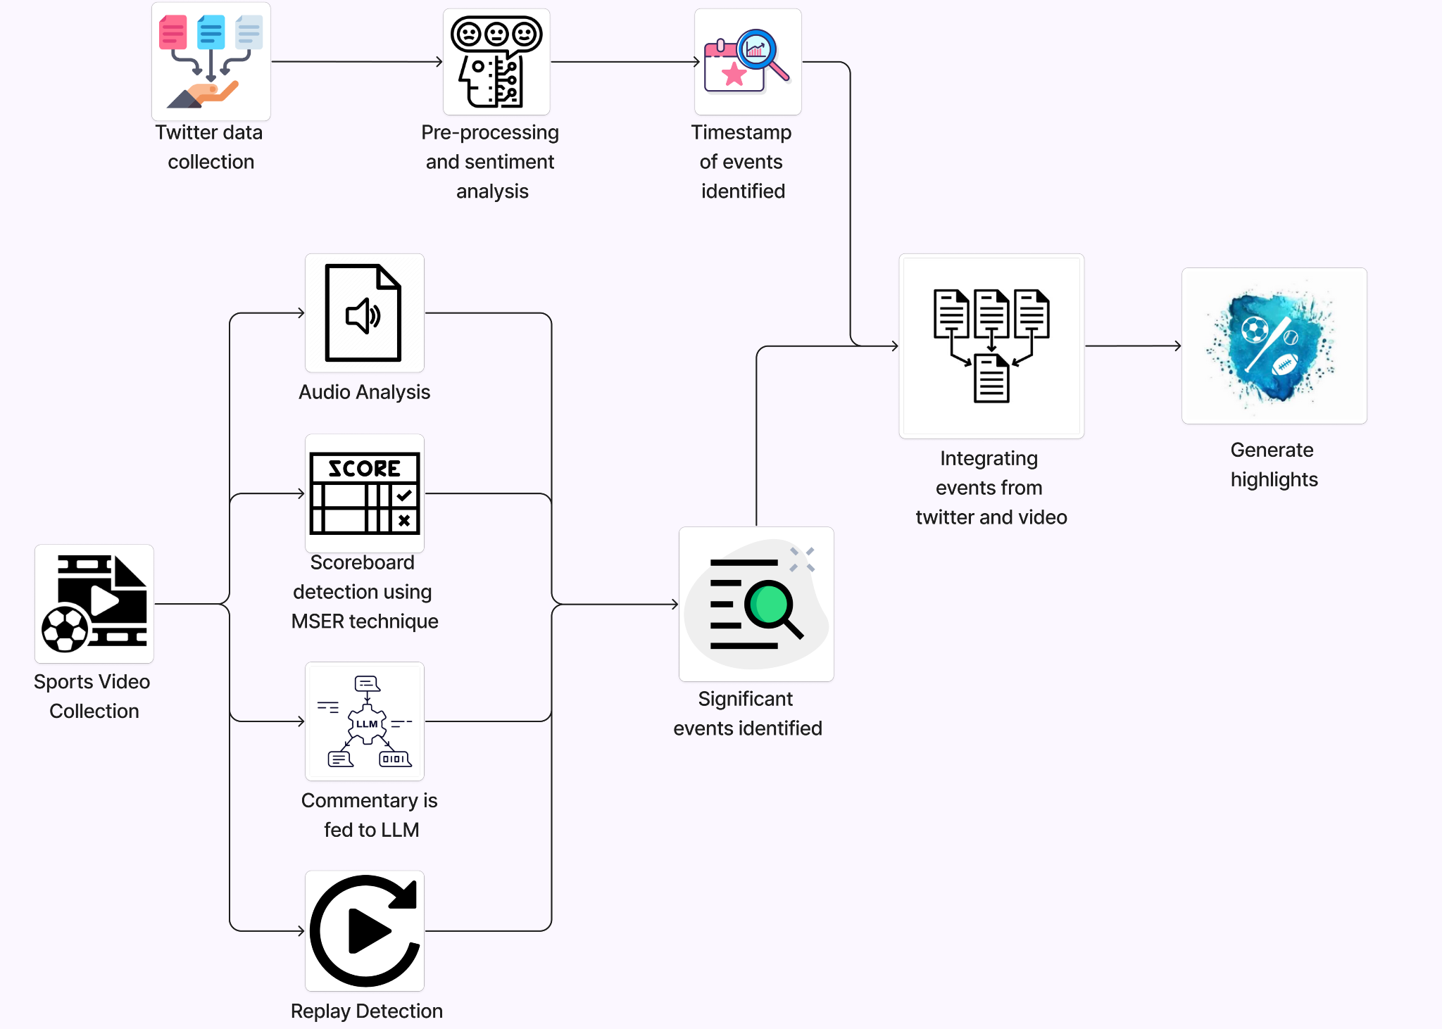
Architecture (if applicable)

Slide 31
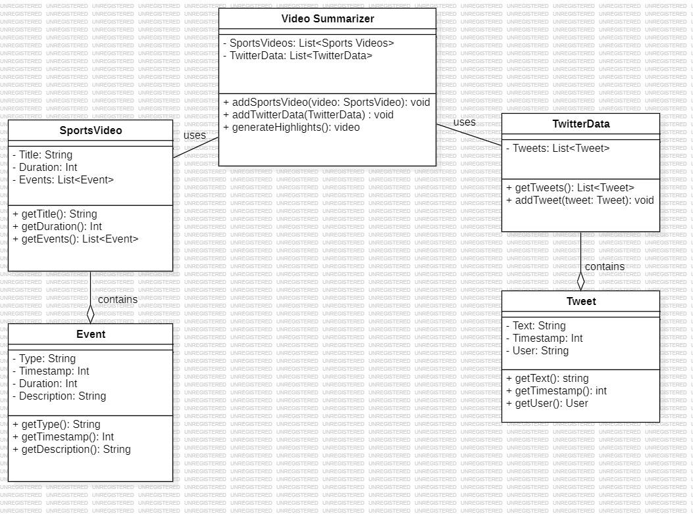
Design Description (if applicable)
Master class diagram

Slide 32
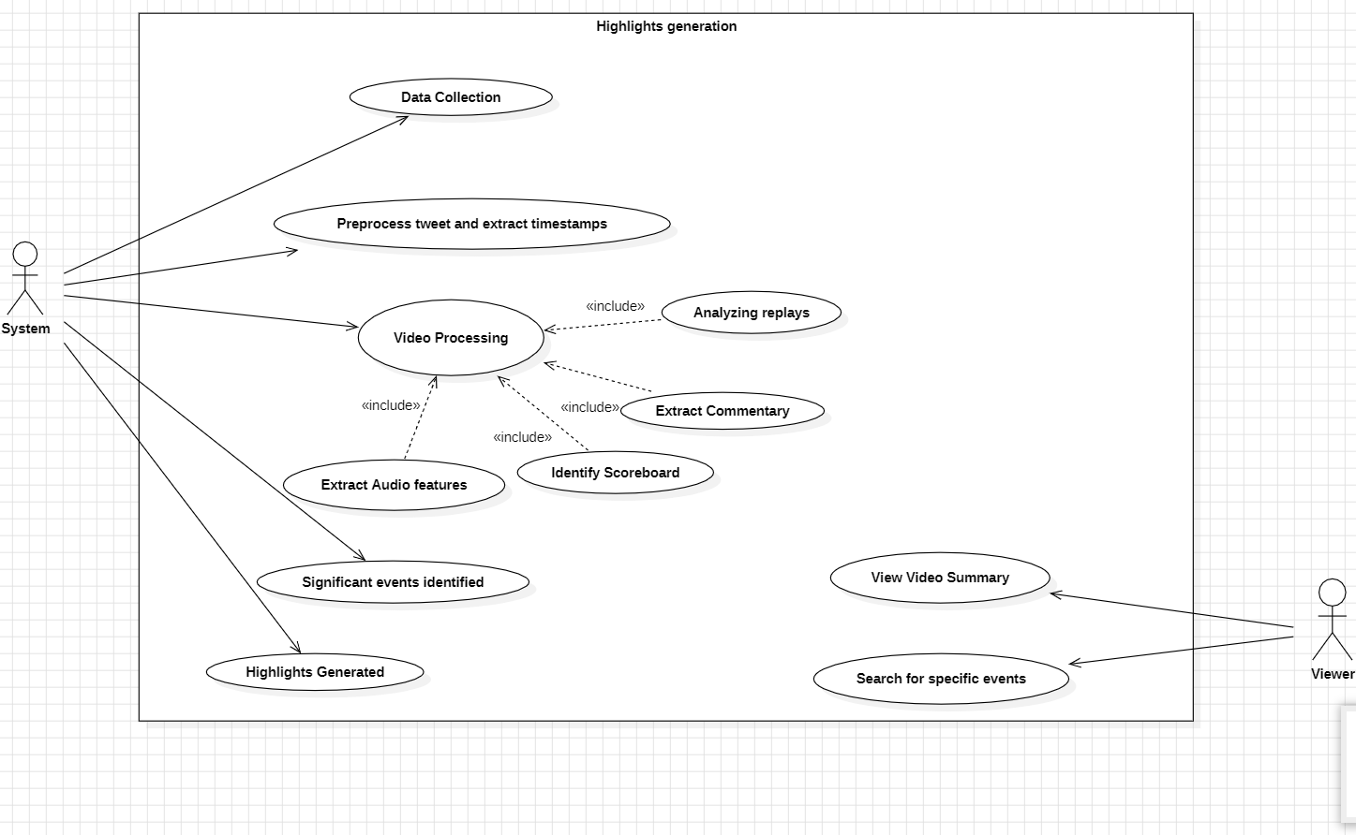
Design Description (if applicable)
Use Case Diagram

Slide 33
Project Progress
The ESA report has been completed and we have obtained the plagiarism report
What is the project progress so far?
As of now, the project has finalized a clear problem statement, conducted an in-depth literature review, and crafted an architecture diagram detailing the system's structure and design approach. Additionally, our team has meticulously planned the selection of models, technologies, and methodology to be employed in the project's implementation. We have also acquired the relevant datasets.
What is the percentage completion of the project?
25%

Slide 34
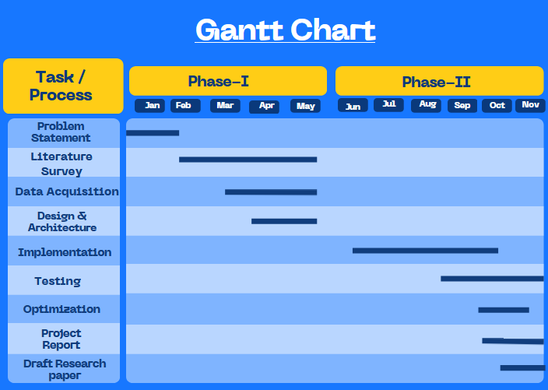
Capstone (Phase-I & Phase-II) Project Timeline

Slide 35
Conclusion
The Automated Sports Summarization System addresses the time constraints and labor-intensive nature of manual summarization methods for sports highlights.
We use twitter data analysis, video and audio processing, and advanced techniques like MSER (Maximally Stable Extremal Regions)-based scoreboard identification, it efficiently generates concise yet comprehensive summaries of sports events.
By incorporating Large language model (LLM) and computer vision, the system enhances event matching and scene classification and we use weighted dynamic heartbeat graph in order to find new emerging event from tweets and multimodal variational autoencoder(Tl-MVAE).

Slide 36
References
Hirasawa K, Maeda K, Ogawa T, Haseyama M. Detection of Important Scenes in Baseball Videos via a Time-Lag-Aware Multimodal Variational Autoencoder. Sensors (Basel). 2021 Mar 14;21(6):2045. doi: 10.3390/s21062045. PMID: 33799412; PMCID: PMC7999231.
A. Javed, K. B. Bajwa, H. Malik and A. Irtaza, "An Efficient Framework for Automatic Highlights Generation from Sports Videos," in IEEE Signal Processing Letters, vol. 23, no. 7, pp. 954-958, July 2016, doi: 10.1109/LSP.2016.2573042
H. Sattar, M. S. Umar, E. Ijaz and M. U. Arshad, "Multi-Modal Architecture for Cricket Highlights Generation: Using Computer Vision and Large Language Model," 2023 17th International Conference on Open Source Systems and Technologies (ICOSST), 2023, pp. 1-6, doi: 10.1109/ICOSST60641.2023.10414235
Z. Saeed, R. Ayaz Abbasi, M. I. Razzak and G. Xu, "Event Detection in Twitter Stream Using Weighted Dynamic Heartbeat Graph Approach [Application Notes]," in IEEE Computational Intelligence Magazine, vol. 14, no. 3, pp. 29-38, Aug. 2019, doi: 10.1109/MCI.2019.2919395

Slide 37
References
5 . Raj, R., Bhatnagar, V., Singh, A. K., Mane, S., & Walde, N. (2021, January 21).
Video Summarization: Study of various techniques. arXiv.org. https://arxiv.org/abs/2101.08434
6 . Video Summarization Study Of Various Techniques Proceedings of IRAJ International Conference,26th May, 2019
7. Z. Saeed, R. Ayaz Abbasi, M. I. Razzak and G. Xu, "Event Detection in Twitter Stream Using Weighted Dynamic Heartbeat Graph Approach [Application Notes]," in IEEE Computational Intelligence Magazine, vol. 14, no. 3, pp. 29-38, Aug. 2019, doi: 10.1109/MCI.2019.2919395

Slide 38
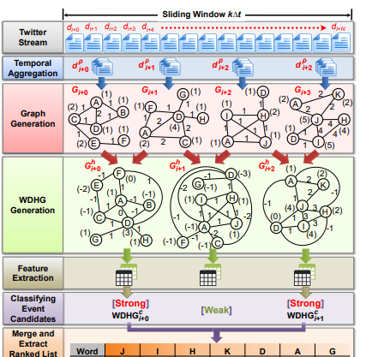
Here we calculate values of J=(4+1+2+3+3+1)=14,
H=6.we calculated based on growth factor.

Slide 39
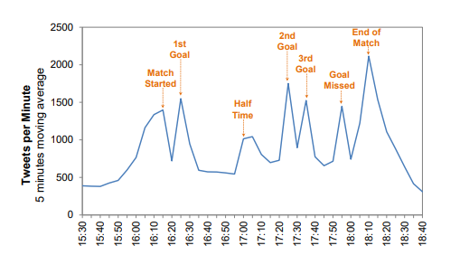

Slide 40
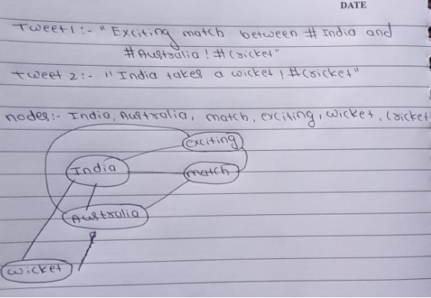

Slide 41
Thank You

